Slide 1


Department of Computer Science University of Bristol
COMSM0086 – Object-Oriented Programming
POLYMORPHISM AND DOUBLE DISPATCH
Sion Hannuna | sh1670@bris.ac.uk
Simon Lock | simon.lock@bris.ac.uk

Slide 2
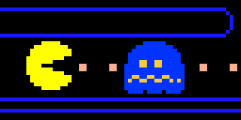
double Dispatch

Slide 4
What is double and / or multiple dispatch?
Dispatch based on two or more types
Single dispatch:
mammal.makeNoise();
Resolves mammal to its underlying type and calls its makeNoise method rather than mammal’s
Double dispatch:
(mammal1 & mammal2).makeNoise();
Depends on which mammals are interacting!
Why might you do this?

Slide 5
What is multiple dispatch?
Dispatch based on two or more types
Single dispatch:
mammal.makeNoise();
Resolves mammal to its underlying type and calls its makeNoise function rather than mammal’s
Double dispatch:
(mammal1 & mammal2).makeNoise();
Depends on which mammals are interacting!
Why might you do this?
Collision detection in games (for example)

Slide 6
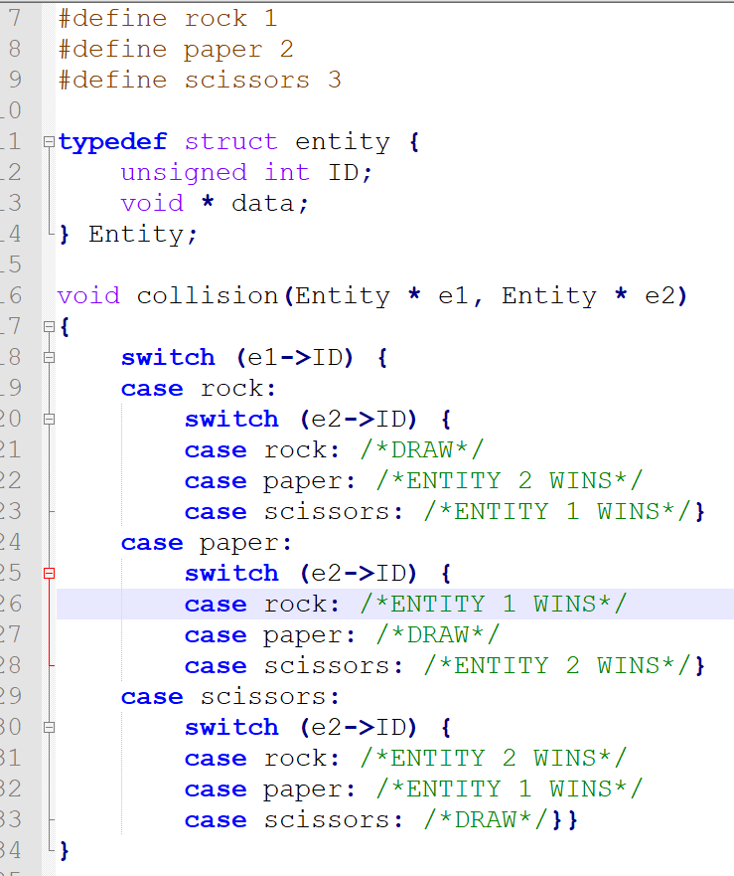
Multiple Dispatch – the Big Switch

Slide 7
Criticisms of the Big Switch
Good
Code is relatively easy to step through
Bad
Adding/removing types is a big job which will not be verified by a compiler
Need a type field for all types and have to keep track of all types
Switch statements tend to grow and show up as code replication throughout the project

Slide 8
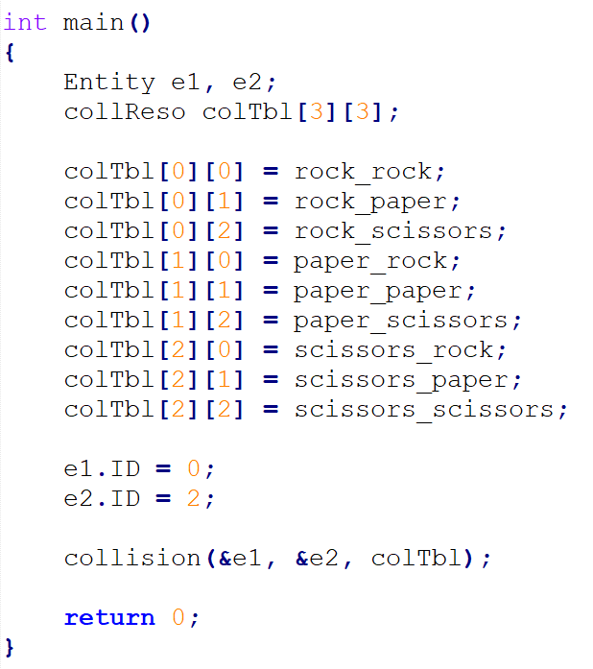
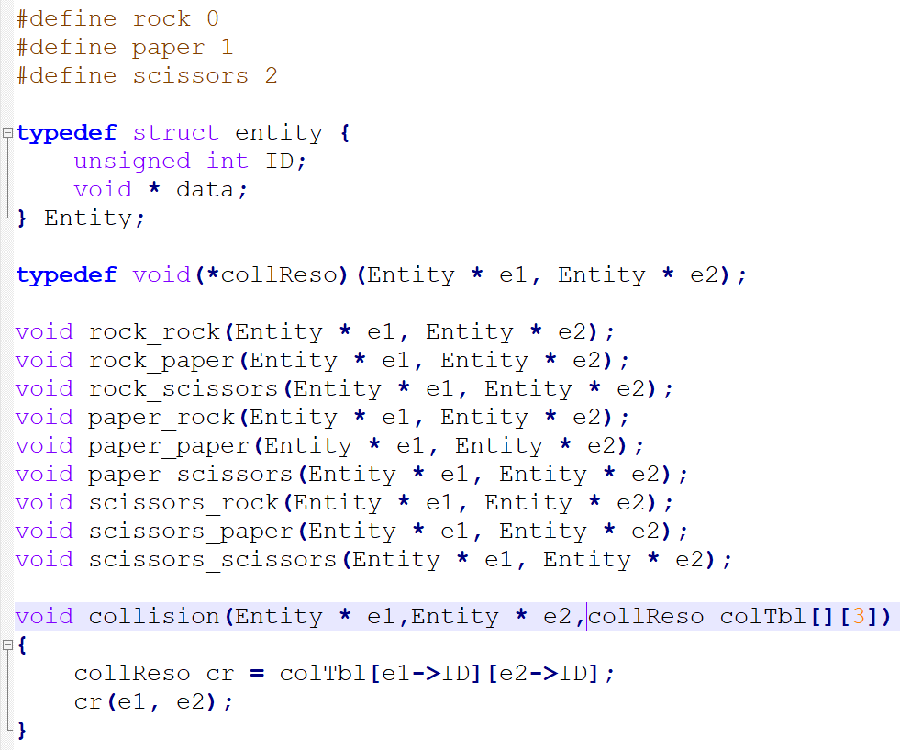
Multiple Dispatch – Function pointer / dispatch table

Slide 9
Criticisms of Function table
Good
Tables are disentangled from code.
Table modification has less side-effects with regards to the code which uses them (in contrast to the switch statement approach).
Bad
Debugging / stepping through is awful
Still require type field for all types

Slide 10
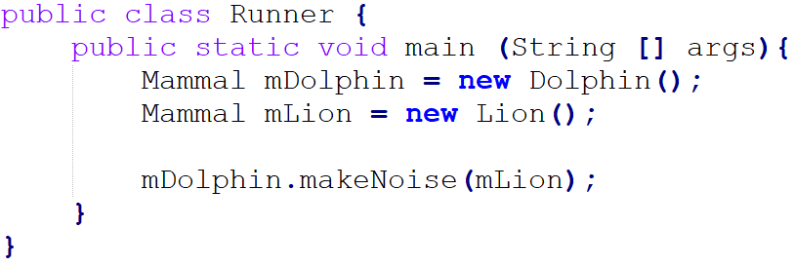
How can we do this in Java?
You might be tempted to do something like this (it won’t work):
And then update the mammal class and its children to provide overloaded functions for each scenario …
Notes:
Mammal_stuff

Slide 11
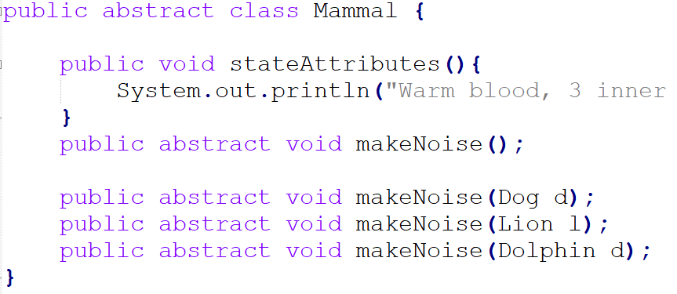
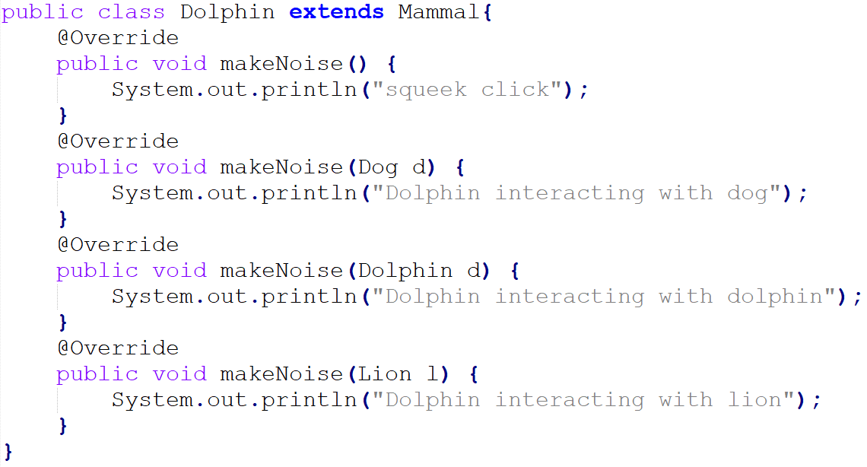
How can we do this in Java?
But it wont work because each function is expecting a particular type of mammal: call parameters, even if they are references, are treated as static …

Slide 12
Double dispatch in Java
Mammals and their children (done)
Rock paper scissors (done)

Slide 13
Criticisms of OO Approach
Good
Many errors caught at compile time
Avoids the issues inherent to switch-based solutions
Bad
Hard to understand - especially for those unfamiliar with Visitor design pattern
It is an object oriented solution which violates many object oriented ideas
breaks encapsulation - function call interacts with more than one type

Slide 14
Multiple Dispatch (Robot example) .
abstract class AbstractRobot extends Robot {
abstract void greet(AbstractRobot other);
abstract void greet(TranslationRobot other);
abstract void greet(CarrierRobot other);
}
AbstractRobot.java
if we want to make the selection of method dynamic in more than one type we need to implement multiple dispatch
Java does not explicitly supply a single mechanism for it
however, we can be cunning and utilise single dispatch recursively
to do this, we need to dynamically dispatch on a receiver as before, but also turn the otherwise static parameter of the call into a dynamic receiver itself within the method that is dynamically dispatched
class CarrierRobot extends AbstractRobot {
...
void greet(TranslationRobot other) {
talk("'Hello from a TranslationRobot to a CarrierRobot.'"); }
void greet(CarrierRobot other) {
talk("'Hello from a CarrierRobot to another.'"); }
void greet(AbstractRobot other) {
other.greet(this);
} }
CarrierRobot.java
2nd dispatch dynamically using the incoming parameter
different options are selected during runtime
public class TranslationRobot extends AbstractRobot {
...
void greet(TranslationRobot other) {
talk("'Hello from a TranslationRobot to another.'"); }
void greet(CarrierRobot other) {
talk("'Hello from a CarrierRobot to a TranslationRobot.'"); }
void greet(AbstractRobot other) {
other.greet(this);
} }
TranslationRobot.java
class DispatchWorld {
public static void main (String[] args) {
AbstractRobot c3po = new TranslationRobot("e");
AbstractRobot c4po = new TranslationRobot("o");
AbstractRobot c5po = new CarrierRobot();
AbstractRobot c6po = new CarrierRobot();
c3po.greet(c4po);
c5po.greet(c4po);
c4po.greet(c5po);
c5po.greet(c6po);
} }
1st dispatch dynamically on receiver
DispatchWorld.java

